Slide 1
ICT001

Slide 2
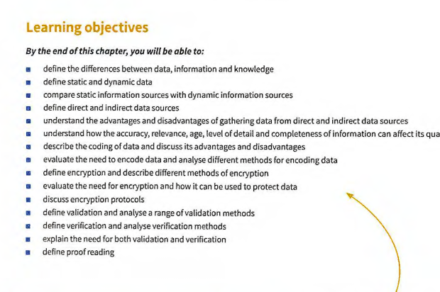
Learning Objective

Slide 3
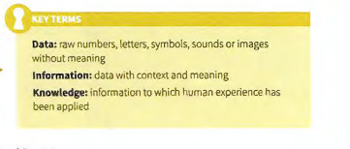

Slide 4
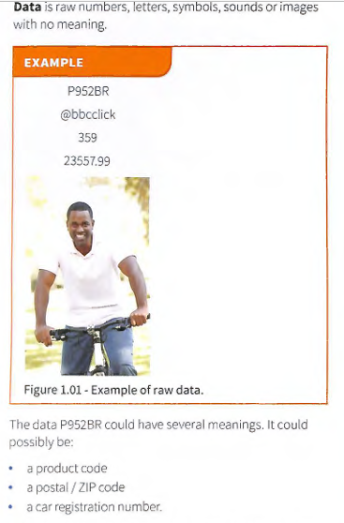

Slide 5
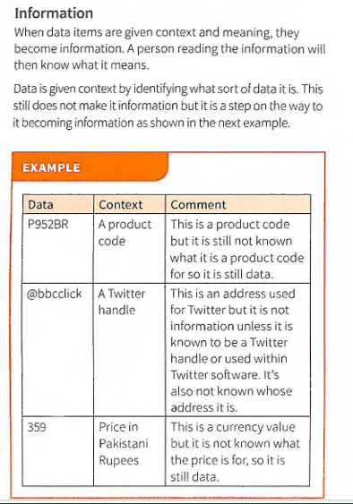

Slide 6
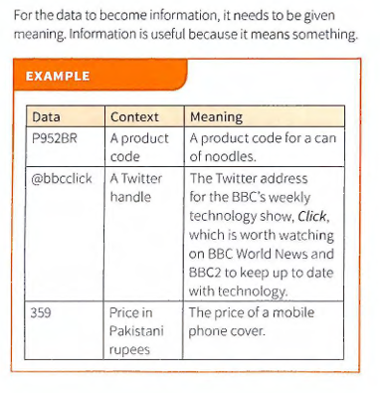

Slide 7
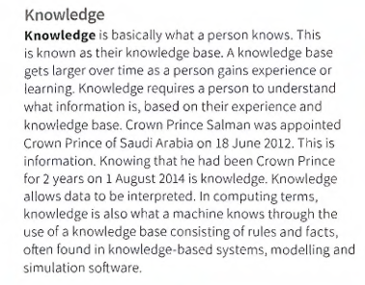

Slide 8
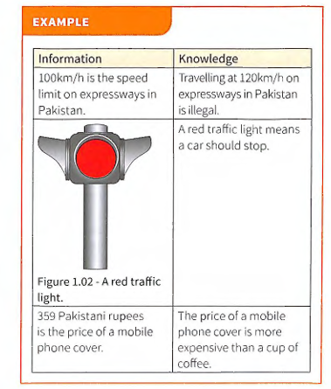

Slide 9
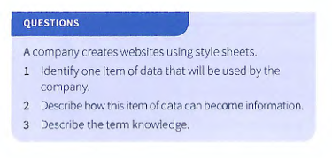

Slide 10
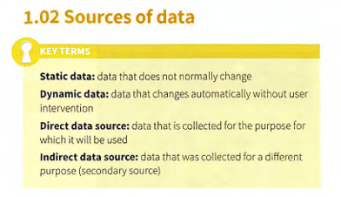

Slide 11
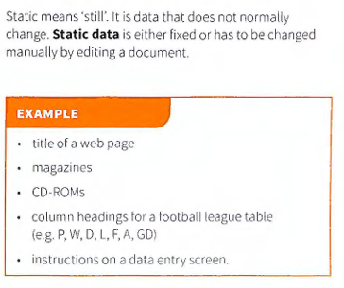

Slide 12
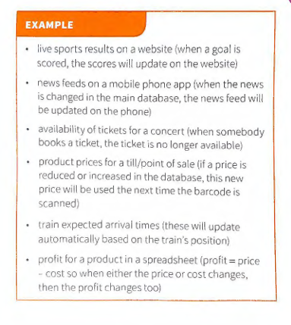
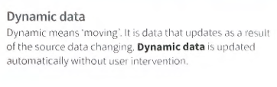

Slide 13
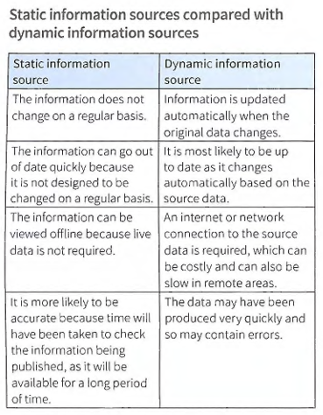

Slide 14
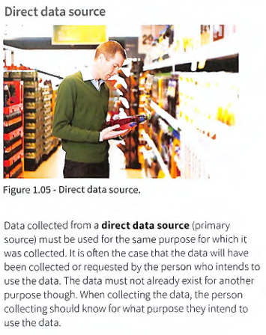
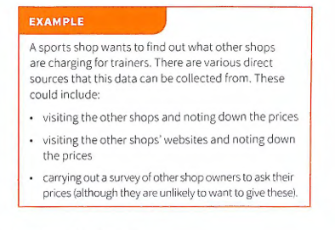

Slide 15
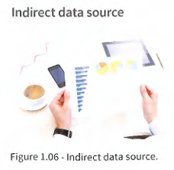
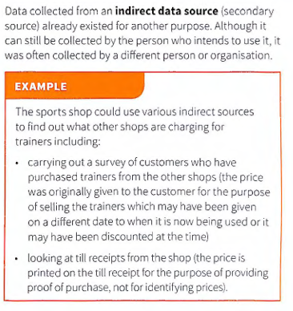

Slide 16
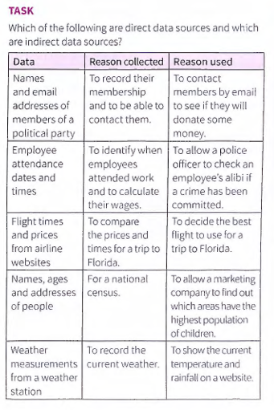

Slide 17
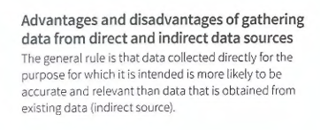

Slide 18
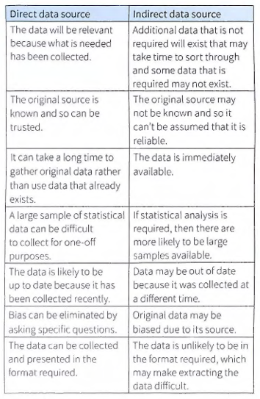

Slide 19
Quality of Information
The quality of information is determined by a number of attributes. Accuracy Information that is inaccurate is clearly not good enough . Data must be accurate in order to be considered of good quality. Imagine being told that you need to check in at the airport 45 minute s before the flight leaves, so you turn up at 18:10 for a 19:05 flight only to find that you were actually supposed to check in one hour early.

Slide 20
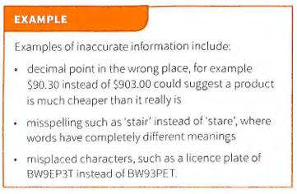

Slide 21
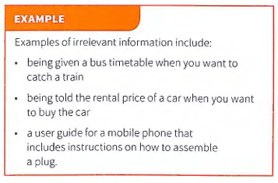
Relevance
Information must be relevant to its purpose. Having additional informat ion that is not required means that the user has to search through the data to find what is actually required.

Slide 22
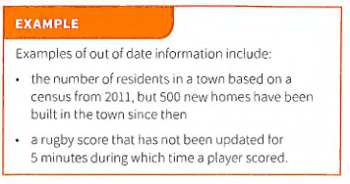
Age
Information must be up to date in order to be useful. Old information is likely to be out of date and therefore no longer useful. When using indirect data sources, always check when the information was produced .

Slide 23
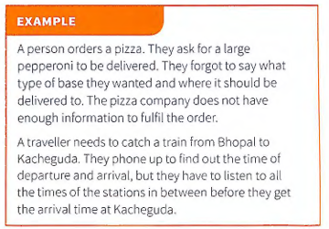
Level of Detail
There needs to be the right amount of information for· it to be goo d quality. It 's possible to have either too little or too much information provided. If there is too much information, then it can be difficult to find the exact information require d. If there is not enough information. then it is not possible to use it correctly.

Slide 24
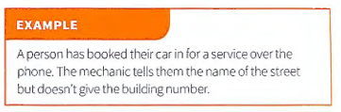
Completeness
All information that is required must be provided in order for it to be of good quality. Not having all the information required means it cannot be used properly.

Slide 25
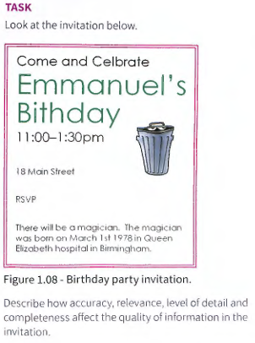
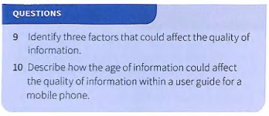

Slide 26
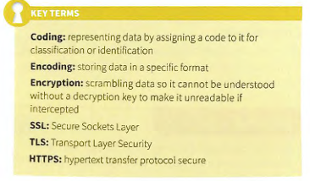
Coding, Encoding and Encrypting Data

Slide 27
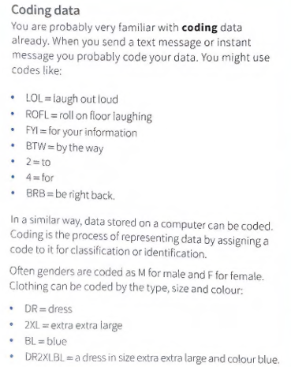

Slide 28
Advantages and Disadvantages of Coding Data
There are a number of reasons for coding data . In the examples used above, it would take a long time to use all the letters of a country to dial a telephone number and t here would not be enough space on the rear of a car to display the full country name.

Slide 29
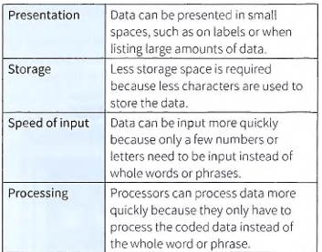
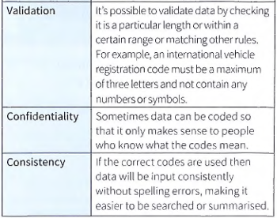
ADVANTAGES OF CODING DATA

Slide 30
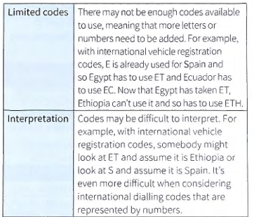
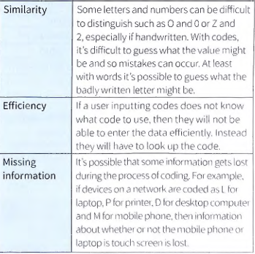
Disadvantage of Coding

Slide 31
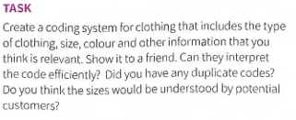
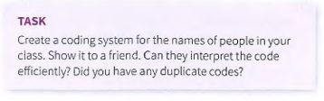

Slide 32
Encoding Data
When data is encoded, it is stored in a specific format. Computers do not recognize text, sound and images in the same way we do. Computers use binary digits which are ls and Os. One means on and zero means off. A typical binary number would look like this: 11011010. Therefore, data needs to be encoded into a format which the compute r understands . Codecs are programs that are used to encode data for images, audio and video. The codecs are also needed to read the data .

Slide 33
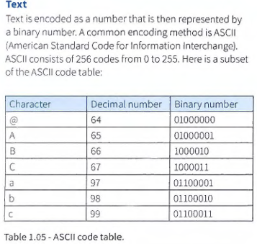

Slide 34
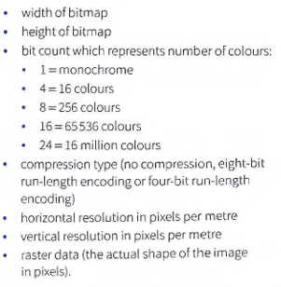
Images
Images Encoding is also used to store images . At the most basic level, images are encoded as bitmaps . A Microsoft Windows bitmap includes the following data when encoding an image (this is not the complete list) :

Slide 35
For the raster data, we will assume a monochrome imag e (black and wh ite). Each bit will represent either a black or white pixe l. A byte con sis ts of eig ht bit s and so will represent eight pixels . The encod ing starts from the bottom left of the image, works to th e right- hand side and then up to the next row and again from left to ri ght.

Slide 36
Question 1
An image has a resolution of 800 × 600 pixels. Each pixel is stored using 24 bits. Calculate the file size of the image in megabytes (MB). Show your working.
Question 2
A bitmap image has a resolution of 1024 × 768 pixels. The colour depth is 8 bits per pixel. The image is compressed by 50% before being stored. Calculate the storage required in kilobytes (KB) after compression.
Question 3
A digital camera stores images at a resolution of 4000 × 3000 pixels. Each pixel requires 36 bits (to allow for high colour depth). Calculate the uncompressed file size in megabytes (MB). (1 MB = 1024 × 1024 bytes)

Slide 37
Question 4
A student scans a black-and-white line drawing at a resolution of 1200 × 1600 pixels. Each pixel requires 1 bit. Calculate the file size in kilobytes (KB).
Question 5
An image has dimensions 1920 × 1080 pixels. It is stored using 16 bits per pixel. The image is then compressed to 25% of its original size. Calculate the storage needed in megabytes (MB) after compression.

Slide 38
Question 6
A photograph is to be printed at 300 dpi with a physical size of 4 inches × 6 inches.
Calculate the required pixel dimensions of the image.
Question 7
Two images have the same dimensions: 1024 × 768 pixels.
Image A uses 8-bit color depth.
Image B uses 24-bit color depth. Calculate the file sizes of both images (in bytes and MB), ignoring metadata

Slide 39
Bit rate
Bit rate is the quantity of digital data transmitted or processed per unit of time, usually measured in bits per second (bps), kilobits per second (kbps), or megabits per second (Mbps)
It determines the amount of information in a file, with higher bit rates producing higher quality but larger file sizes and greater bandwidth requirements, while lower bit rates result in smaller files with reduced quality. Choosing the appropriate bit rate is a crucial balance between quality and file size for multimedia content like video and audio.
bit rate= sample rate x bit depth x number of channels

Slide 40
BIT DEPTH
Bit depth is a digital media term for the number of bits used to represent the color of a single pixel in an image or the amplitude of each sample in an audio recording, directly impacting the number of possible colors or sound levels that can be expressed. A higher bit depth allows for greater color precision and a broader range of colors in an image (e.g., 24-bit color) or a more accurate, nuanced representation of sound in audio.

Slide 41
Sample Rate
A sample rate is the frequency at which a continuous analog signal, like sound, is measured and converted into a digital format, expressed in Hertz (Hz) or samples per second. A higher sample rate captures more data points per second, resulting in a more accurate and detailed digital representation of the original analog signal, which is crucial for high-fidelity audio and video. For instance, 44.1 kHz is standard for CDs and captures a wide range of human hearing, while 48 kHz is common in video production.

Slide 42
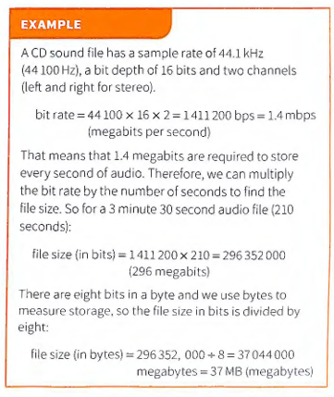

Slide 43
A sound sample has a sample rate of 44,100 Hz and a sample resolution of 16 bits. Calculate the storage needed for 10 seconds of mono sound.
The same sound in Q1 is now stored in stereo. Calculate the new storage requirement.
Explain the difference between sample rate and sample resolution.
State how increasing the sample rate affects: (a) the quality of the sound, (b) the file size.
A sound file has a file size of 8 MB. It is sampled at 22,050 Hz with a resolution of 8 bits in mono. Calculate the approximate duration of the recording.
Describe how analog sound is converted into digital form before being stored in a computer system.
A song is recorded using a 24-bit resolution and a sample rate of 96,000 Hz in stereo. Explain why this produces very large files compared to CD-quality sound.
Give two advantages and two disadvantages of using lossy compression for storing sound.
Explain the difference between uncompressed formats (e.g. WAV) and compressed formats (e.g. MP3) in terms of storage and quality.

Slide 44
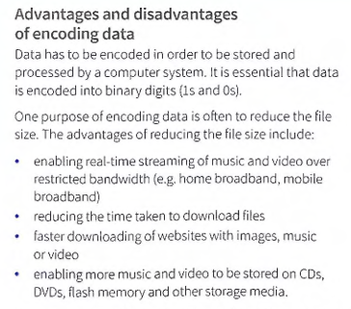
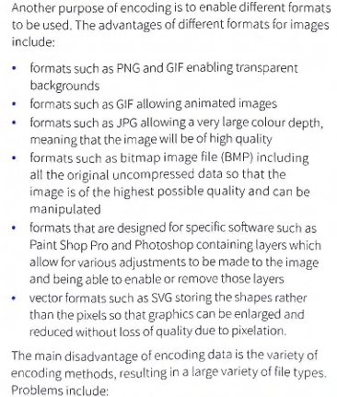

Slide 45
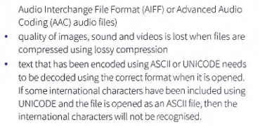

Slide 46
Encryption
Encryption One specific type of encoding is encryption. This is when data is scrambled so that it cannot be understood. The purpose of encryption is to make the data difficult or impossible to read if it is accessed by an unauthorized user. Data can be encrypted when it is stored on disks or other storage media, or it can be encrypted when it is sent across a network such as a local area network or the internet. Accessing encrypted data legitimately is known as decryption .
CAESAR CIPHER
Caesar cipher A cipher is a secret way of writing. In other words it is a code. Ciphers are used to convert a message into an encrypted message. It is a special type of algorithm which defines the set of rules to follow to encrypt a message. Roman Emperor Julius Caesar created the Caesar cipher so that he could communicate in secret with his generals. The Caesar cipher is sometimes known as a shift cipher because it selects replacement letters by shifting along the alphabet .

Slide 47
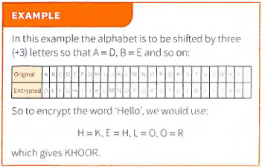

Slide 48
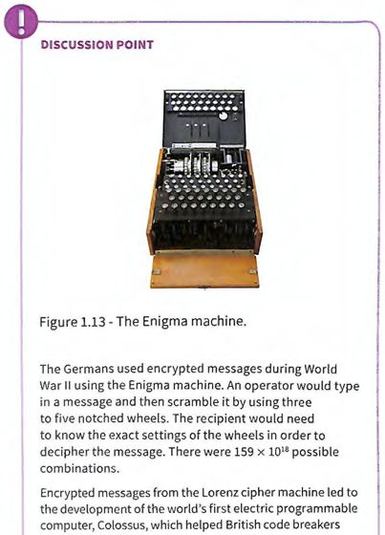
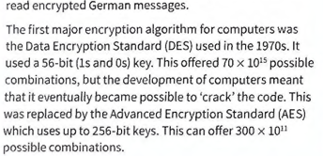

Slide 49
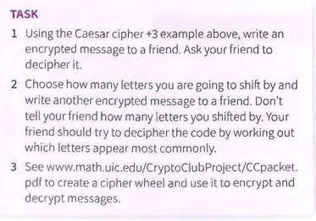

Slide 50
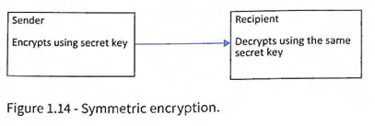
Symmetric Encryption
Symmetric encryption This is the oldest method of encryption. It requires both the sender and recipient to possess the secret encryption and decryption key. With symmetric encryption, the secret key needs to be sent to the recipient. This could be done at a separate time, but it still has to be transmitted whether by post or over the internet and it could be intercepted.

Slide 51
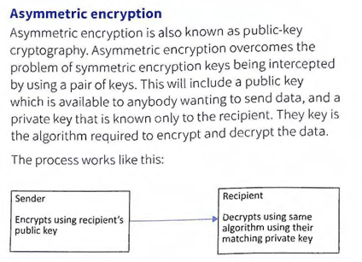

Slide 52
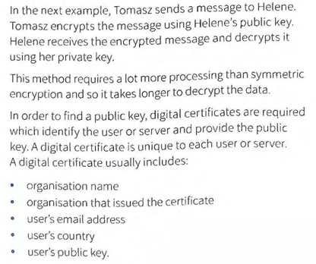

Slide 53
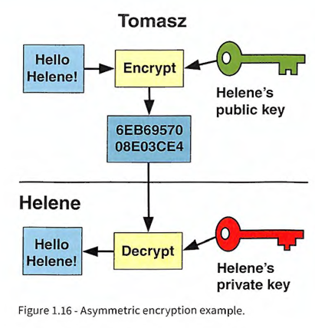

Slide 54
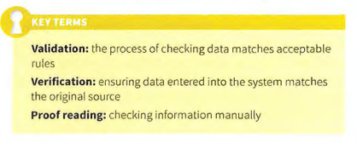
Checking the accuracy of data

Slide 55
Validation
Validation takes place when data is input into a computer system. The purpose is to ensure the data is sensible and conforms to defined rules. A railway season ticket will have an expiry date. The season ticket is valid until it expires. Once it expires it is invalid. The rule here is that the date the season ticket is used must be before its expiry date. When data is validated, if it conforms to the rules then it will be accepted. If it does not conform to the rules, then it will be rejected and an error message will be presented. Validation does not ensure that data is correct.

Slide 56


Slide 57



Slide 58



Slide 59



Slide 60




Slide 61
Check digit
A check digit is a number (or letter) that is added to the end of an identification number being input. It is a form of redundancy check because the check digit is redundant (not needed for the identification number, but just used for validation). When the identification number is first created, an algorithm (a series of calculations) is performed on it to generate a check digit. When the identification number is input , the same algorithm is performed on it. The result of the algorithm should match the check digit. If it matches, then the data is valid. If it does not match then the data is invalid .

Slide 62


Slide 63




Slide 64



Slide 65
Verification
Verification is the process of checking that the data entered into the computer system matches the original source
VISUAL CHECKING
Visual checking: A method of verification can be for the user to visually check that the data entered matches the original source. This can be done by reading the data displayed on screen and comparing it with the original data. If the data matches, then it has passed the verification process. If it does not match, then it has failed the verification process and needs to be re-entered. Visual checking does not ensure that the data entered is correct. If the original data is wrong, then the verifi cation process may still pass. For example, if the intended data is ABCD but ABC is on the source document, then ABC will be entered into the computer and verified, but it should have been ABCD in the first place.

Slide 66




Slide 67




